Slide 1

University of Central Florida COP 3330 Object Oriented Programming

Slide 2
Agenda
Administrative
Unified Modeling Language

Slide 3
Unified Modeling Language

Slide 4
UML
Unified Modeling Language
is a general-purpose modeling language for software engineering
designed to provide a standardized ability to visualize the design of a system
created and developed by Grady Booch, Ivar Jacobson, and James Rumbaugh 1994–95 with continued development through 1996
1997 adopted as a standard by the Object Management Group (OMG) and has been managed by this organization since
2000 UML was accepted by the International Organization for Standardization (ISO) as an approved ISO standard

Slide 5
UML
UML allows for visualizing a system's architectural blueprints in a diagram
any activities (jobs)
individual components of the system and how they interact with other software components
how the system will run
how entities interact with others (components and interfaces)
external user interface

Slide 6
UML
UML model’s set of diagrams of a system
A diagram is a partial graphic representation of a system's model
The set of diagrams need not completely cover the model and deleting a diagram does not change the model
The model may also contain documentation that drives the model elements and diagrams (such as written use cases).
UML diagrams represent two different views
Static (or structural) view emphasizes the static structure of the system using objects, attributes, operations and relationships
class diagrams
composite structure diagrams
Dynamic (or behavioral) view emphasizes the dynamic behavior of the system by showing collaborations among objects and changes to the internal states of objects
sequence diagrams
activity diagrams
state machine diagrams

Slide 7
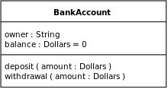
Structural
Class diagrams
The classes in a class diagram represent the main objects, interactions in the application, and the classes to be programmed
The top part contains the name of the class. It is printed in bold and centered, and the first letter is capitalized
The middle part contains the attributes of the class. They are left-aligned and the first letter is lowercase
The bottom part contains the methods the class can execute. They are also left-aligned and the first letter is lowercase

Slide 8
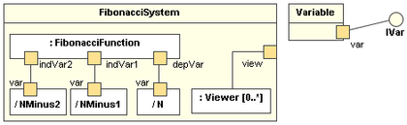
Structural
Composite structure diagrams
key composite structure entities defined in the UML 2.0 specification are
Structured classifier represents a class
Part represents a role played at runtime by one instance of a classifier or by a collection of instances
Ports is an interaction point that can be used to connect structured classifiers with their parts and with the environment
Connectors binds two or more entities together, allowing them to interact at runtime
Collaboration is generally more abstract than a structured classifier

Slide 9
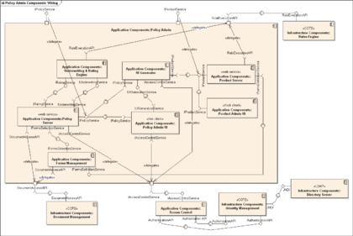
Structural
Component diagrams
depict how components are wired together to form larger components and or software systems
used to illustrate the structure of arbitrarily complex systems

Slide 10
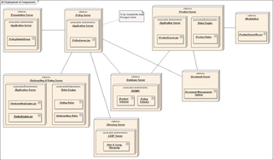
Structural
Deployment diagrams
Models the physical deployment of artifacts on nodes

Slide 11
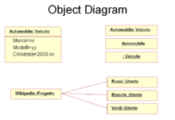
Structural
Object diagrams
shows a complete or partial view of the structure of a modeled system at a specific time

Slide 12
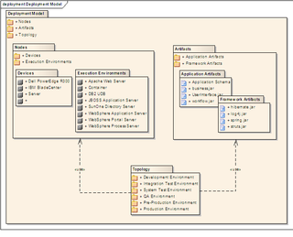
Structural
Package diagrams
depicts the dependencies between the packages that make up a model

Slide 13
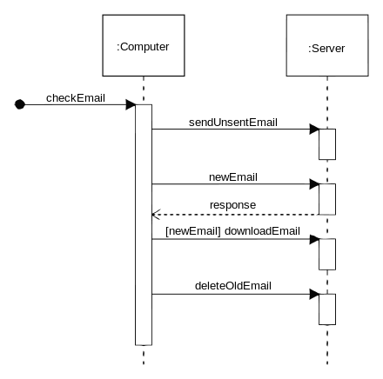
Behavioral
Sequence diagrams
is an interaction diagram that shows how processes operate with one another and in what order

Slide 14
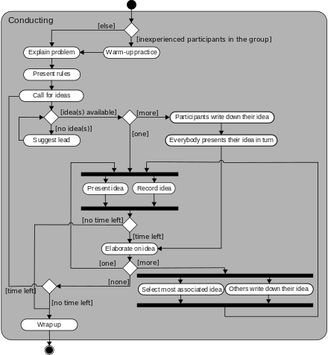
Behavioral
Activity diagrams
are graphical representations of workflows of stepwise activities and actions with support for choice, iteration and concurrency

Slide 15
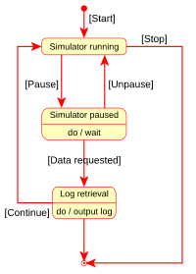
Behavioral
State machine diagrams
describe many systems
computer programs
business processes

Slide 16
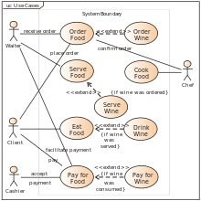
Behavioral
Use case diagrams
is a representation of a user's interaction with the system and depicting the specifications of a use case
can portray the different types of users of a system and the various ways that they interact with the system

Slide 17
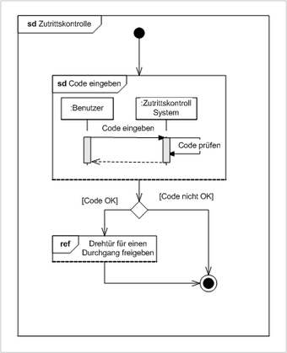
Behavioral
Interaction overview diagrams
which can picture a control flow with nodes that can contain interaction diagrams

